Slide 1
Computer Networks 21CSA212
Lecture: Physical Layer

Slide 2
Contents
Transmission Media
Analog Transmission
Digital Transmission

Slide 3
Introduction
The physical layer is the first and lowest layer from the bottom of the 7-layered OSI model and delivers security to hardware.
It is the foundation on which the network is built.
Physical layer comes under the category of hardware layers
It consist of network components such as power plugs, connectors, receivers, cable types etc

Slide 4
Functions of physical layer
It transfers data bit by bit or symbol by symbol.
It performs bit synchronization, which means that only one bit needs to be transferred from one system to another at a time. There should be no overlapping of bits during transmission. Bit synchronization can be achieved by providing a clock.
Bit rate control defines how many bits per second can be transmitted, i.e., the number of bits sent per second.
It is responsible for the translation of data received from the data link layer for further transmission.
It is also responsible for maintaining the data quality by applying the necessary protocols and maintaining the data bit rate.
It also specifies the network topology and transmission mode

Slide 5
Attributes of Physical Layer
Signals: The data is first converted to a signal for efficient data transmission. There are two kinds of signals: Analog and Digital signals
Transmission media: Data is carried from source to destination with the help of transmission media. There are two sorts of transmission media: wireless and wired
Data Flow: It describes the rate of data flow and the transmission time frame. The factors affecting the data flow are as follows: bandwidth and error rate

Slide 6
Transmission mode: It describes the direction of the data flow. Data can be transmitted in three sorts of transmission modes as follows: simplex, half-duplex and full-duplex mode.
Simplex mode: This mode of communication is a one-way communication where a device can only send data. Examples are a mouse, keyboard, etc.
Half-duplex mode: This mode of communication supports one-way communication, i.e., either data can be transmitted or received. An example is a walkie-talkie.
Full-duplex mode: This mode of communication supports two-way communication, i.e., the device can send and receive data at the same time. An example is cellular communication.

Slide 7
Guided Transmission media
It is defined as the physical medium through which the signals are transmitted. It is also known as Bounded media.
Types of guided transmission media:
Twisted Pairs
Coaxial Cable
Fiber Optic

Slide 8
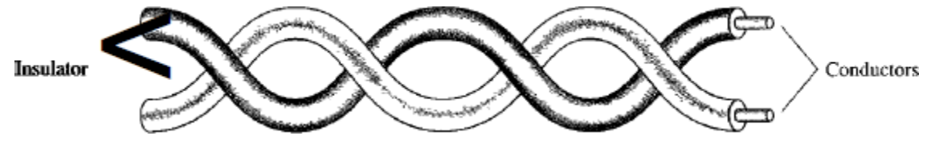
Twisted Pairs
A twisted pair consists of two insulated copper wires, typically about 1mm thickness.
The wires are twisted together in a helical form.
One of the conductors is used to carry the signal and the other is used as a ground reference only.
When the wires are twisted, the waves from different twists cancel out, so the wire radiates less effectively.
The receiver uses the difference of signals between these two conductors.

Slide 9
The noise or crosstalk in the two parallel conductors is high but this is greatly reduced in twisted pair cables due to the twisting characteristic.
In the first twist, one conductor is near to noise source and the other is far from the source but in the next twist the reverse happens and the resultant noise is very less and hence the balance in signal quality is maintained and the receiver receives very less or no noise.
The quality of signal in twisted pair cables greatly depends upon the number of twists per unit length of the cable.

Slide 10
Twisted pairs can be used for transmitting either analog or digital information.
The bandwidth depends upon the thickness of the wire and the distance travelled.
Types of twisted pairs: Unshielded Twisted Pair Cables (UTP) and Shielded Twisted Pair Cables (STP)

Slide 11
Unshielded Twisted Pair Cables (UTP) :
These are a pair of two insulated copper wires twisted together without any other insulation or shielding and hence are called unshielded twisted pair cables.
They reduce the external interference due to the presence of insulation. Unshielded twisted pair cables are arranged in pairs so that we can add a new connection whenever required.

Slide 12
Advantages –
These cables are cost-effective and easy to install owing to their compact size.
They are generally used for short-distance transmission of both voice and data.
It is less costly as compared to other types of cables.
Disadvantages –
The connection established using UTP is not secure.
They are efficient only for a distance up to 100 meters and have to be installed in pieces of up to 100 meters.
These cables have limited bandwidth.

Slide 13
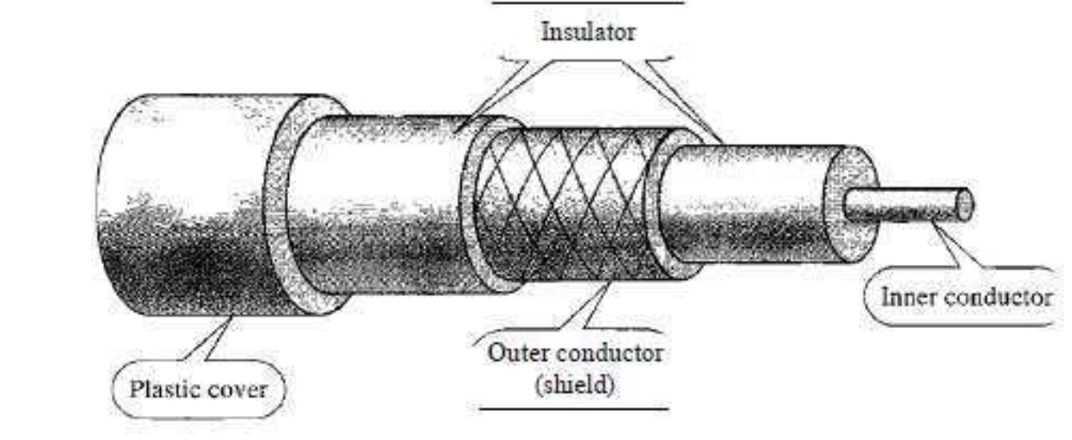
Coaxial Cable
Coaxial cable (or coax) carries signals of higher frequency ranges than those in twisted pair cable, in part because the two media are constructed quite differently.
Instead of having two wires, coax has a central core conductor of solid or stranded wire (usually copper) enclosed in an insulating sheath, which is, in turn, encased in an outer conductor of metal foil, braid, or a combination of the two.
The outer metallic wrapping serves both as a shield against noise and as the second conductor, which completes the circuit.
This outer conductor is also enclosed in an insulating sheath, and the whole cable is protected by a plastic cover .

Slide 14
Coaxial cable are of two types:
Baseband transmission: It is defined as the process of transmitting a single signal at high speed.
Broadband transmission: It is defined as the process of transmitting multiple signals simultaneously.

Slide 15
Advantages Of Coaxial cable:
The data can be transmitted at high speed.
It has better shielding as compared to twisted pair cable.
It provides higher bandwidth.
Disadvantages Of Coaxial cable:
It is more expensive as compared to twisted pair cable.
If any fault occurs in the cable causes the failure in the entire network.

Slide 16
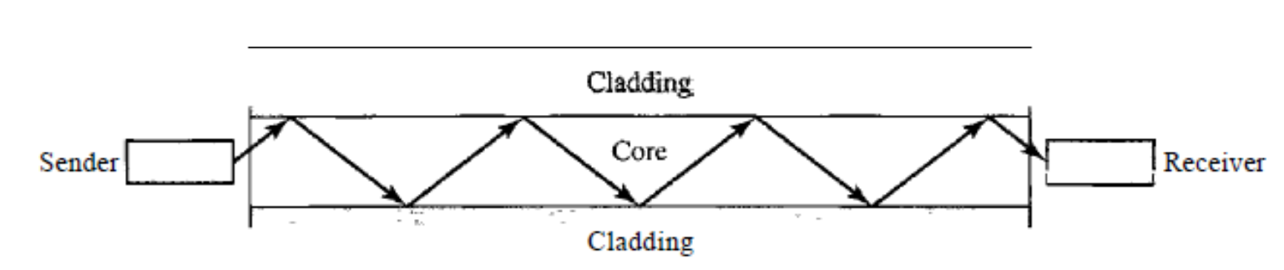
Fiber Optic Cable
A fiber-optic cable is made of glass or plastic and transmits signals in the form of light.
A fiber optic cable is a special type of cable that uses thin strands of glass or plastic to transmit data as light signals. It allows for fast and reliable communication over long distances.
Optical fibers use reflection to guide light through a channel.

Slide 17
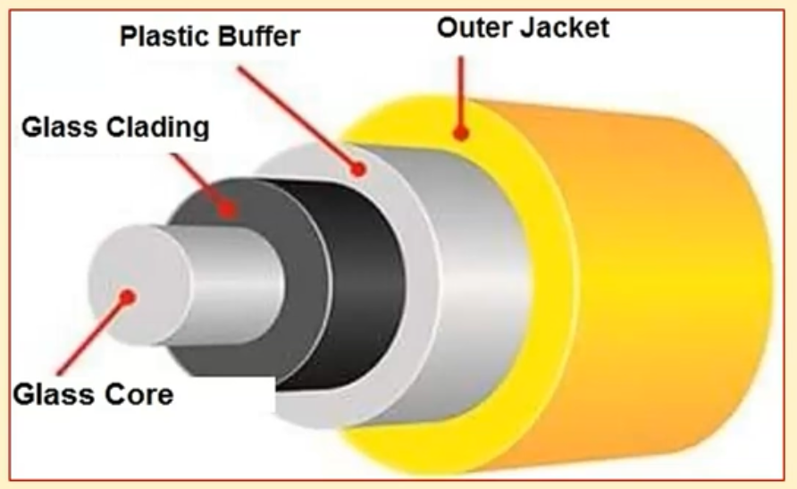
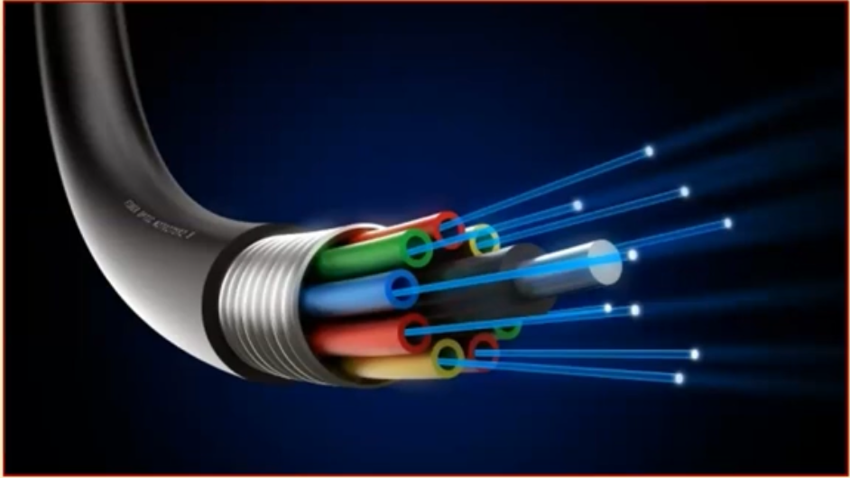

Slide 18
Advantages a. Higher bandwidth. Fiber-optic cable can support dramatically higher bandwidths (and hence data rates) than either twisted-pair or coaxial cable.
b. Less signal attenuation. Fiber-optic transmission distance is significantly greater than that of other guided media. A signal can run for 50 km without requiring regeneration. We need repeaters every 5 km for coaxial or twisted-pair cable.

Slide 19
c. Immunity to electromagnetic interference: Electromagnetic noise cannot affect fiber- optic cables.
d. Light weight. Fiber-optic cables are much lighter than copper cables.

Slide 20
Disadvantages
There are some disadvantages in the use of optical fiber. a. Installation and maintenance. Fiber-optic cable is a relatively new technology. Its installation and maintenance require expertise that is not yet available everywhere.
b. Unidirectional light propagation. Propagation of light is unidirectional. If we need bidirectional communication, two fibers are needed. c. Cost. The cable and the interfaces are relatively more expensive than those of other guided media. If the demand for bandwidth is not high, often the use of optical fiber cannot be justified.

Slide 21
Unguided Media
Unguided media transport electromagnetic waves without using a physical conductor.
This type of communication is often referred to as wireless communication.
Signals are normally broadcast through free space and thus are available to anyone who has a device capable of receiving them. Unguided signals can travel from the source to destination in several ways: ground propagation, sky propagation, and line-of- sight propagation.

Slide 22
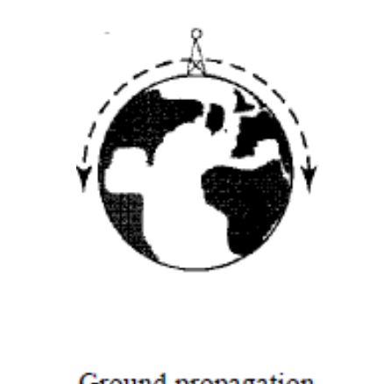
Ground Propagation
In ground propagation, radio waves travel through the lowest portion of the atmosphere,
These low frequency signals emanate in all directions from the transmitting antenna and follow the curvature of the planet.
Distance depends on the amount of power in the signal: The greater the power, the greater the distance.

Slide 23
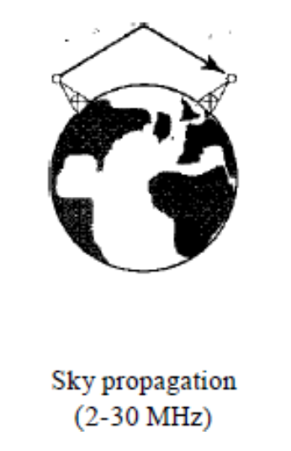
Sky Propagation
In sky propagation, higher-frequency radio waves radiate upward into the ionosphere where they are reflected back to earth.
This type of transmission allows for greater distances with lower output power.

Slide 24
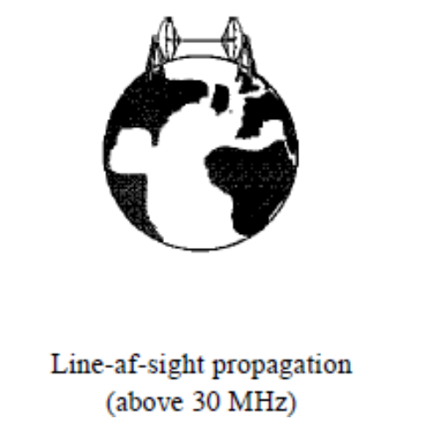
Line-or-sight
In line-or-sight propagation, very high-frequency signals are transmitted in straight lines directly from antenna to antenna. Antennas must be directional, facing each other, and either tall enough or close enough together not to be affected by the curvature of the earth. Line-of-sight propagation is tricky because radio transmissions cannot be completely focused.

Slide 25
Radio Waves
Waves ranging in frequencies between 3 kHz and 1 GHz are called radio waves.
Radio waves are omnidirectional. When an antenna transmits radio waves, they are propagated in all directions. This means that the sending and receiving antennas do not have to be aligned.
A sending antenna sends waves that can be received by any receiving antenna.
The omnidirectional property has a disadvantage, too. The radio waves transmitted by one antenna are susceptible to interference by another antenna that may send signals using the same frequency or band.

Slide 26
Radio waves, particularly those waves that propagate in the sky mode, can travel long distances. This makes radio waves a good candidate for long-distance broadcasting such as AM radio.
Radio waves, particularly those of low and medium frequencies, can penetrate walls. This characteristic can be both an advantage and a disadvantage. It is an advantage because, for example, an AM radio can receive signals inside a building. It is a disadvantage because we cannot isolate a communication to just inside or outside a building.
The radio wave band is relatively narrow, just under 1 GHz, compared to the microwave band. When this band is divided into sub bands, the sub bands are also narrow, leading to a low data rate for digital communications.

Slide 27
Microwaves
Electromagnetic waves having frequencies between 1 and 300 GHz are called microwaves.
Microwaves are unidirectional. When an antenna transmits microwave waves, they can be narrowly focused. This means that the sending and receiving antennas need to be aligned. The unidirectional property has an obvious advantage.
A pair of antennas can be aligned without interfering with another pair of aligned antennas.

Slide 28
The following describes some characteristics of microwave propagation:
a. Microwave propagation is line-of-sight. Since the towers with the mounted antennas need to be in direct sight of each other, towers that are far apart need to be very tall. The curvature of the earth as well as other blocking obstacles does not allow two short towers to communicate by using microwaves. Repeaters are often needed for long distance communication.

Slide 29
b. Very high-frequency microwaves cannot penetrate walls. This characteristic can be a disadvantage if receivers are inside buildings.
c. The microwave band is relatively wide, almost 299 GHz. Therefore wider sub bands can be assigned, and a high data rate is possible
d. Use of certain portions of the band requires permission from authorities. ​

Slide 30
Infrared
Infrared waves, with frequencies from 300 GHz to 400 THz (wavelengths from 1 mm to 770 nm), can be used for short-range communication.
Infrared waves, having high frequencies, cannot penetrate walls.
This advantageous characteristic prevents interference between one system and another; a short-range communication system in one room cannot be affected by another system in the next room.

Slide 31
When we use our infrared remote control, we do not interfere with the use of the remote by our neighbors.
However, this same characteristic makes infrared signals useless for long-range communication.
In addition, we cannot use infrared waves outside a building because the sun's rays contain infrared waves that can interfere with the communication.

Slide 32
Modulation and Demodulation
There are two important processes used in data communication namely, modulation and demodulation.
Both these processes make a communication successful by the transfer of data and information with the minimum distortion, minimum losses .
The electronic device that is employed to perform modulation and demodulation is called modem. It performs modulation and demodulation of information during its transmission.

Slide 33
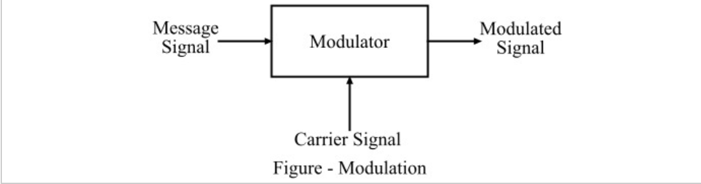
Modulation
The process of superimposing a message signal on a carrier signal so that the message can be transmitted over long distances is called modulation. Here, the carrier signal is the signal of high frequency which is used to carry the message signal.
The modulation of a signal is performed at the transmitting end in the communication system with the help of a modulator circuit (a part of modem)
In the modulation, a specific parameter, i.e. amplitude, frequency or phase, of the carrier signal is altered in accordance with the modulating signal or message signal. After modulation, the modulated signal is transmitted over the communication channel by a transmitter.

Slide 34
Modulation – It is the process of converting digital data (0s and 1s) into analog signals so that it can be transmitted over communication channels like telephone lines, radio waves, or fiber optics.
• Example: In an internet connection, a modem modulates digital signals from a computer into analog signals for transmission.
Demodulation – It is the reverse process, where the analog signal is converted back into digital data so that a computer can understand it.
• Example: The modem demodulates incoming analog signals from the internet and converts them into digital data for your computer.

Slide 35
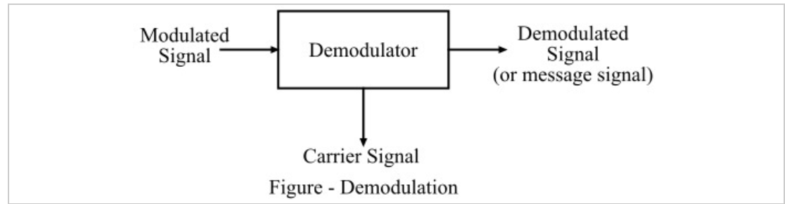
Demodulation
The process of obtaining the original message from the modulated signal is called demodulation.
In simple words, demodulation is the process of separating a message signal from a carrier signal.
The electronic circuit that is used to perform the demodulation process is called demodulator, it is the part of the modem. The process of demodulation is performed at the receiver end of a communication system.

Slide 36
Why are they Important
Used in modems (MOdulator-DEModulator) for internet connections.
Enable long-distance communication over networks.
Improve signal strength and quality for data transmission.

Slide 37
Simple Example: Radio Broadcasting
• A radio station uses modulation to convert sound (music/news) into signals that can be transmitted over radio waves.
• Your radio receiver uses demodulation to convert the signals back into sound so you can hear it.

Slide 38
Multiplexing
Multiplexing is a technique which combines multiple signals into one signal, suitable for transmission over a communication channel such as coaxial cable or optical fiber.
Multiplexing is the process of simultaneously transmitting two or more individual signals over a single communication channel.
Multiplexing is done by using a device called Multiplexer or MUX. The multiplexer combines n input lines to generate one output line.
The recovery of multiple signals back to their original form is known as demultiplexing.

Slide 39
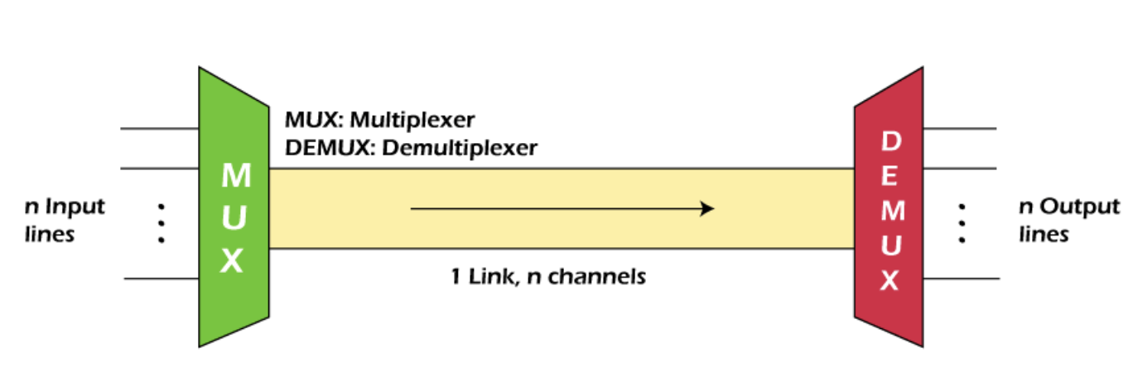
Multiplexing

Slide 40
Frequency-division Multiplexing (FDM)
The main aim of the FDM is to subdivide the available bandwidth into different frequency channels and allocate them to different devices.
FDM is mainly used in radio broadcasts and TV networks.
FDM is used for analog signals.
FDM process is very simple and easy modulation.
A large number of signals can be sent through an FDM simultaneously.
It does not require any synchronization between sender and receiver.
It requires a high bandwidth channel, suffers the problem of crosstalk

Slide 41
Wavelength Division Multiplexing (WDM)
Wavelength Division Multiplexing is same as FDM except that the optical signals are transmitted through the fiberoptic cable.
It is also known as bidirectional multiplexing
WDM is used on fiber optics to increase the capacity of a single fiber.
Optical signals from different source are combined to form a wider band of light with the help of multiplexer.
At the receiving end, demultiplexer separates the signals to transmit them to their respective destinations.
Multiplexing and Demultiplexing can be achieved by using a prism.

Slide 42
Time Division Multiplexing
In case of Time Division Multiplexing technique, all signals operate at the same frequency with different time.
In TDM the total time available in the channel is distributed among different users. Therefore, each user is allocated with different time interval known as a Time slot at which data is to be transmitted by the sender.
The data is not transmitted simultaneously rather the data is transmitted one-by-one.
Two types of TDM- Synchronous and Asynchronous

